Slide 1
CAPSTONE PROJECT
NAME: Rohan Pralhad Dhunde
EDA : Customer Churn data analysis

Slide 2
Capstone Project Submission
NO | Name | Email
1. | Rohan Dhunde | rohandhunde8@gmail.com
Github link : https://github.com/rohandhunde/EDA-telocom-churn-analysis

Slide 3
Content
Business Problem
Objective
Data Summary
Exploratory Data Analysis
Challenges
Recommendation
Conclusion
Q & A

Slide 4
Bussness Problem Understanding
Customer churn in the telecom industry is a major revenue
The telecom industry faces a significant risk of revenue loss due to customer churn, with an average monthly churn rate of around 1.9% and the potential for an annual churn rate as high as 67%, as per a conducted survey.
Since the cost of acquiring new customers is up to 25 times higher than the cost of retaining them, reducing the churn rate of customer is key.
To reduce customer churn, telecom companies need to predict which customers are at high risk of churn for this we taking advantage of the vast streams of rich telecom customer data.
This project aims to analyse the data to determine the cause of customer churn customers who are most likely subject to churn, and what to do to retain the most valuable customer.

Slide 5





DATA SUMMARY
Numarical Data
Decision Variable
#Account length,
# Area code,
# Number voice
mail messages
# Total day minutes
# Total day calls
# Total day charge
# Total eve minutes
# Total eve calls
# Total eve charge
# Total night minutes
# Total night calls
# Total night charge
# Total intl minutes
# Total intl calls
# Total intl charge
# Customer service calls
# Churn
Categorical Data
#Stata
#International plan
#Voicemail Plan
Nominal Data
#State

Slide 6
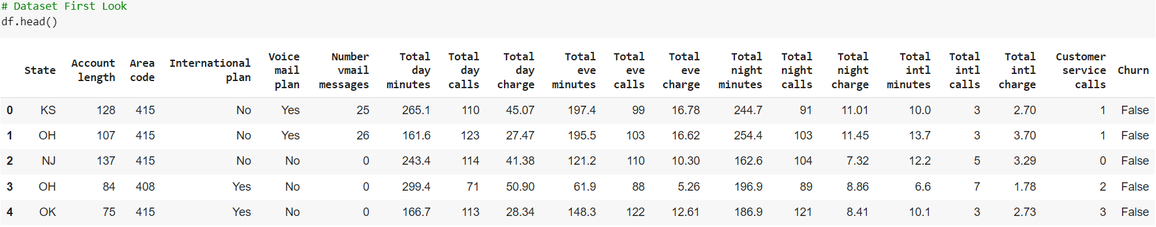
Data Summary
This is the telicom churn dataset in the bwlow its show the top and bottom of the sample of the dataset

Slide 7
Features Description
STATE: There are 51 unique state present ACCOUNT
LENGTH:It is the length that the customer used their account
AREA CODE: There are 3 unique area code present
TOTAL (DAY/EVENING/NIGHT/INTERNATIONAL) (MINUTES/CALLS/CHARGES)These are total 12 columns, and all are numerical data types. These contain the data of calls, minutes, charges of the customer with respective to the various time of the day and plan.
INTERNATIONAL PLAN & VOICEMAIL PLAN customerBoth column are described as a categorical feature yes means plan taken no means plan not taken
NO. OF MESSAGES:The number of voicemail make by the voicemail plan taken
Customer
Customer service calls : it is the number of calls made by the customer to operator service center
Churn : it is our target dependent variable having boolean data type of true and false

Slide 8
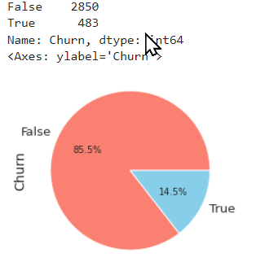
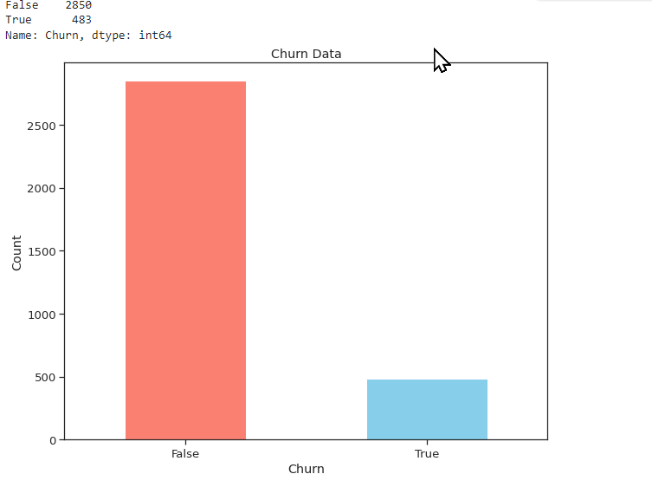
Analysis Dependent variable “Churn” # The plot below displays how the data is distributed in the dataset, providing insight into its characteristics.

Slide 9
Analysing Dependant Variable “Churn”
Total Users numbers : 3333.
2850 – Non Churn (85.5%)
483 – Churn (14.5%)
Based on the analysis of the barplot and the peaplot, it was discovered that approximately 14.5% of customers had churned. This finding highlights the importance of monitoring customer retention to ensure business success and underscores the need for effective strategies to reduce customer churn.

Slide 10
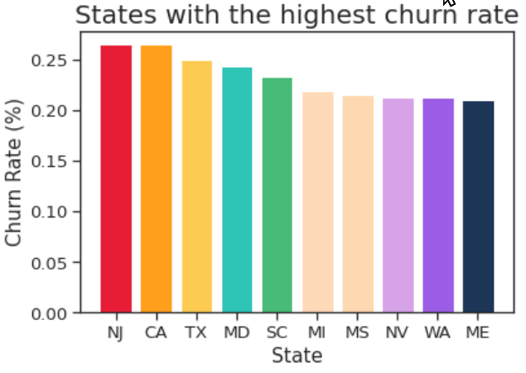
# "Exploring Customer Churn Across States: A Visual Representation"

Slide 11
State with highest churn rate
“ State with highest rate” : identify the state with highest generate in our dataset.
“high churn rate in NJ and CA” : highlight that both New Jersey (NJ) and California (CA) exhibit high churn rates.

Slide 12
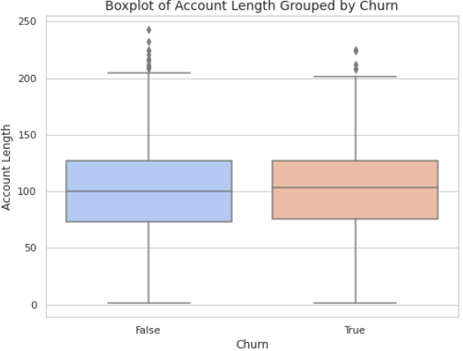
Churn customer Analysis # this below plot show the Churn customer along with the account length

Slide 13
Churn customer Analysis
"Churn vs. Account Length": Analyzing the relationship between churn (x-axis) and account length (y-axis), we observe that the majority of customers who churned have account lengths below 100.
"Churn Distribution": The number of customers with account lengths below 100 who churned (represented by the false values) is significant, indicating a higher churn rate among customers with shorter account durations.
"Longer Account Lengths and Churn": On the other hand, customers with account lengths exceeding 100+ have a lower churn rate (represented by the true values), suggesting the longer account durations may contribute to increased customer retention.

Slide 14
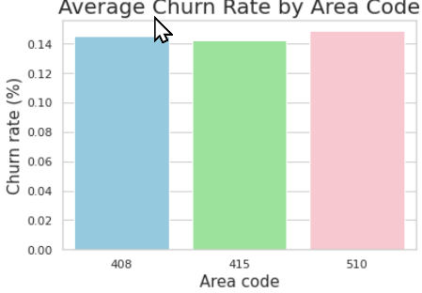
Alalysing the customer churn with area code # This plot displays all the values associated with each area code, providing insight into the distribution and variation of data across different regions. # area code has only 3 unique and it show the churn rate along the areacode

Slide 15
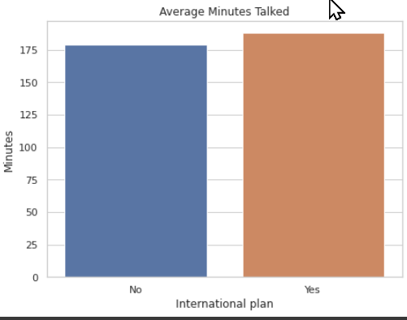
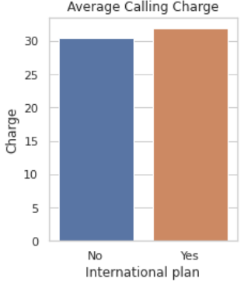
Charges # Comparing Average Call Charges and Talk Time: Insights from a Bar Plot

Slide 16
Charges vs international plan
"International Plan and Increased Talk Time": Customers who have an international plan tend to talk more than customers who don't have an international plan. This indicates that having an international plan encourages higher usage of talk time services.
"Higher Charges for International Plan Users": The charges incurred by customers with an international plan are higher compared to customers without an international plan. This suggests that the additional services and features provided by the international plan result in higher costs for the customers.
"Value of International Plan": The data demonstrates that customers find value in the international plan, as they are willing to talk more and incur higher charges to avail of the benefits its offer.
"Potential Revenue Generation": The higher charges associated with the international plan a potential revenue generation opportunity for the service provider, as customers are willing to for pay the convenience and extended communication options provided by the plan.

Slide 17
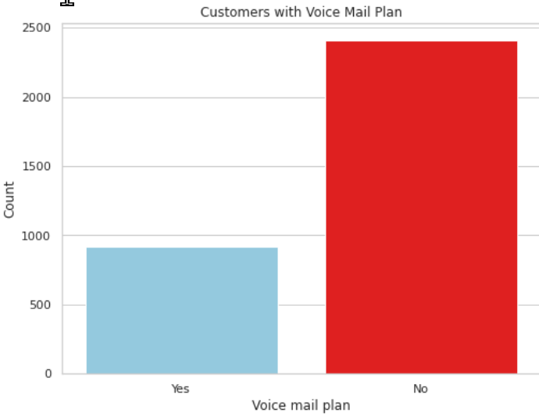
Voicemail plan
#thes plot show the corellation of the customer and vaocemail plan #out OF 922 people having voicemail plan, 8.8% are churn

Slide 18
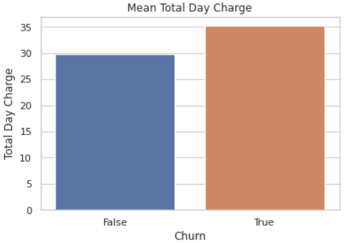
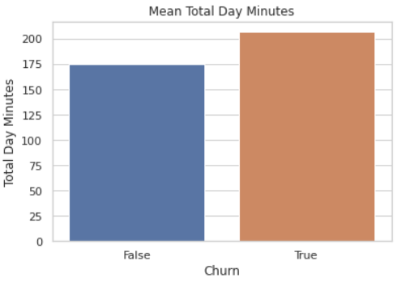
Total Day Calls VS Churn The first plot reveals a key insight: churned customers talk for an average of over 200 minutes, while non-churned customers talk for approximately 175 minutes. Additionally, we observe that churned customers are charged an average of nearly 35$ for their total day minutes, whereas non-churned customers are charged closer to 30$. These findings highlight the importance of call charges and talk time in predicting customer churn and underscore the need for effective retention strategies."

Slide 19
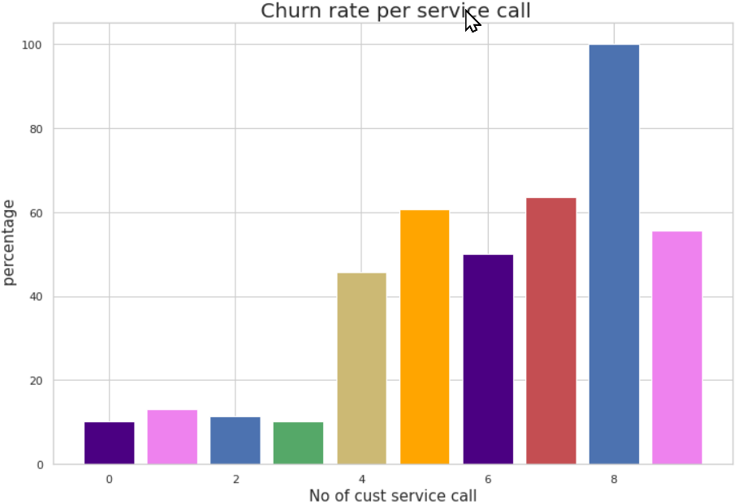
Analyzing Customer Churn Rates Across Services: A Percentile Representation of Customer Count # This plot provides a comprehensive overview of customer churn rates across different services. By analyzing the percentile representation of customer count, we can identify the services with the highest churn rates and prioritize efforts to improve customer retention in those areas. This information can help businesses tailor their strategies to address specific customer needs and pain points, ultimately leading to increased customer loyalty and revenue growth.

Slide 20
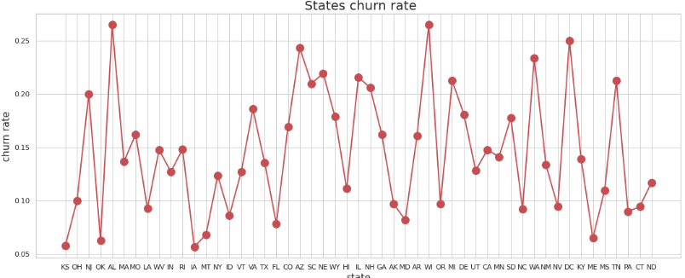
Churn vs state # Analyzing customer churn across states can provide businesses with valuable insights into regional trends and factors that contribute to customer attrition. By leveraging this data, businesses can tailor their retention strategies to improve customer satisfaction and loyalty, ultimately driving long-term growth. Therefore, understanding churn and state data is crucial for businesses looking to reduce churn and improve customer retention.

Slide 21
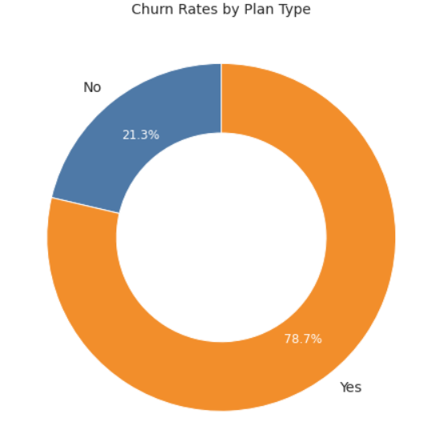
International Plan
There are 3333 people
21.3 % of the customer don’t have any international plan
78.7 % of the customers have international plan

Slide 22
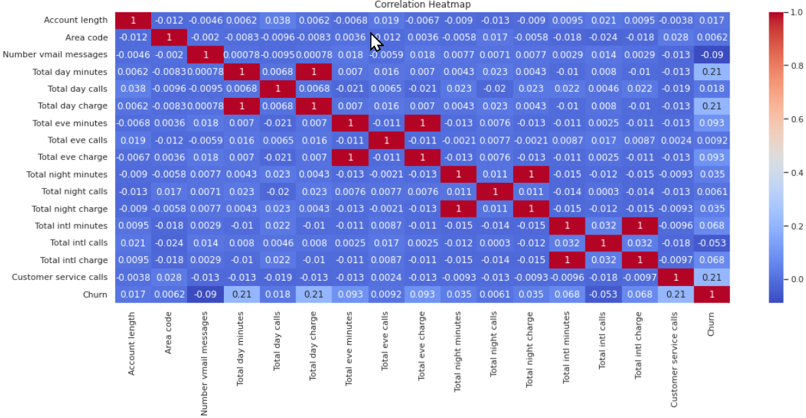
Correlation Matrix

Slide 23
Correlation Matrix
"Churn and Customer Service Calls": There is a moderate positive correlation between the number of customer service calls and churn. This suggests that customers who make more customer service calls are more likely to churn, indicating potential dissatisfaction or unresolved issues.
"International Plan and Total Intl Minutes/Charges": There is a positive correlation between having an international plan and the total international minutes/charges. Customers with an international plan tend to have higher usage and incur more charges for international calls, indicating the value and utilization of the plan.
"Account Length and Total Day Minutes/Charges": There is a weak positive realation
between account length and total day minutes/charges. This suggests that customer with
longer account lengths may tend to have slightly higher usage and charges during the
daytime, possibly indicating loyalty or increased familiarity with the service over time

Slide 24
Challenges
Defficult to analyse column like account length area code
Need to plot lot of graph for columns as to understand the data
For calls data there is no direct relation to churn but related column has played some role.

Slide 25
Conclusion
* The minute fields are more strongly associated with the charge fields than the area code or state fields, which suggests that these fields may not be as important for predicting churn.
* The International Plan field is a strong predictor of churn, suggesting that customers with this plan may have unique needs or concerns that the company should address.
* Customers with high numbers of customer service calls are at a greater risk of churning, indicating that the company should prioritize addressing their concerns and providing quality customer service.
* Customers with high day and evening minutes are also at a higher risk of churning, which suggests that the company should pay special attention to these customers and address any issues they may be experiencing with their service or plan.
* Finally, there is no obvious association between churn and several other variables, including day calls, evening calls, night calls, international calls, night minutes, international minutes, account length, and voicemail messages. However, this does not necessarily mean that these variables are not important for predicting churn, and further analysis may be needed to fully understand their relationship to customer churn.

Slide 26
Recommendations
Improve network coverage for more profit in states
In international plan provide some voicemail quality or take feedback from customer for improvement.
Provide discount to those customer who spend more minutes
Improve the service of call centre and take frequently feedback from the customer regarding their issues and try to solve it as soon as possible.

